Slide 1

BioNetFit
Design Review 3
Team U.I. Fit
Charles Chatwin, Matthew Burns, Joshua Gutman, Tanner Brelje
Mentor & Client: Dr. Abolfazl Razi

Slide 2
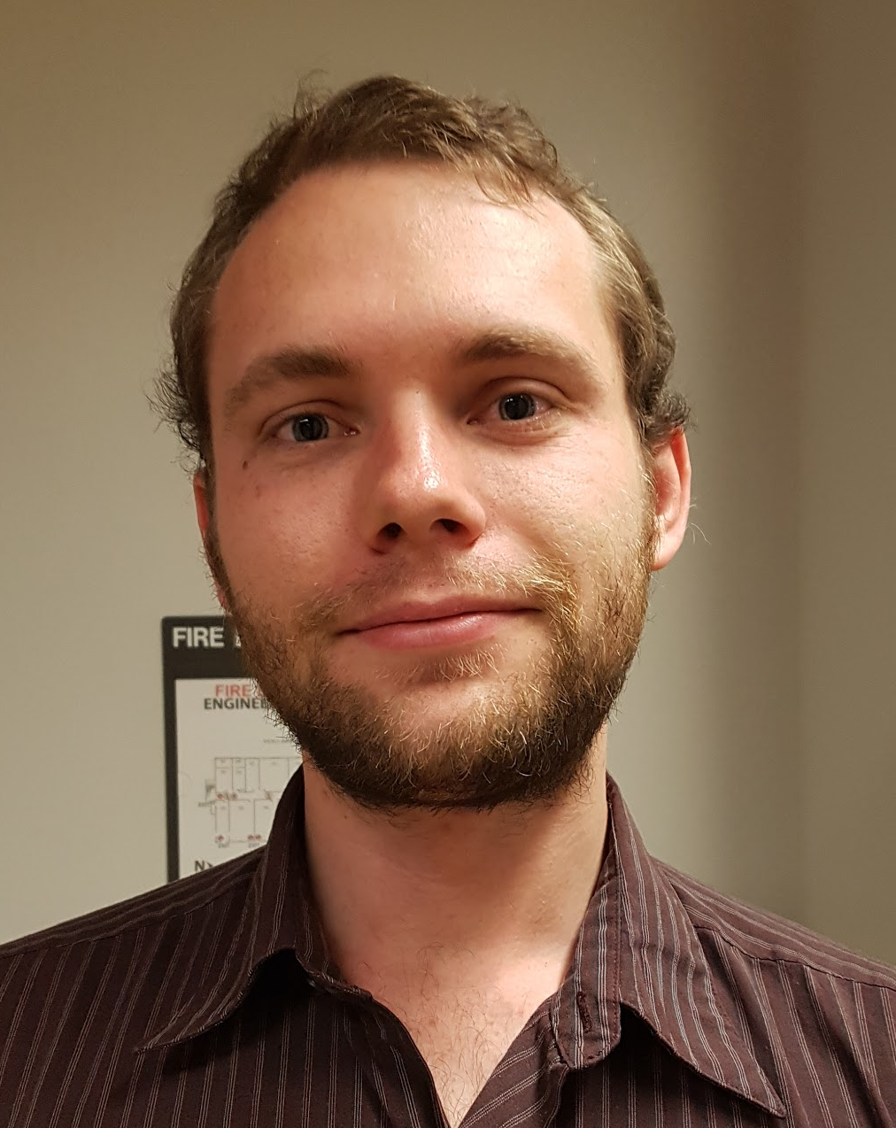
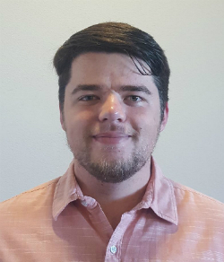
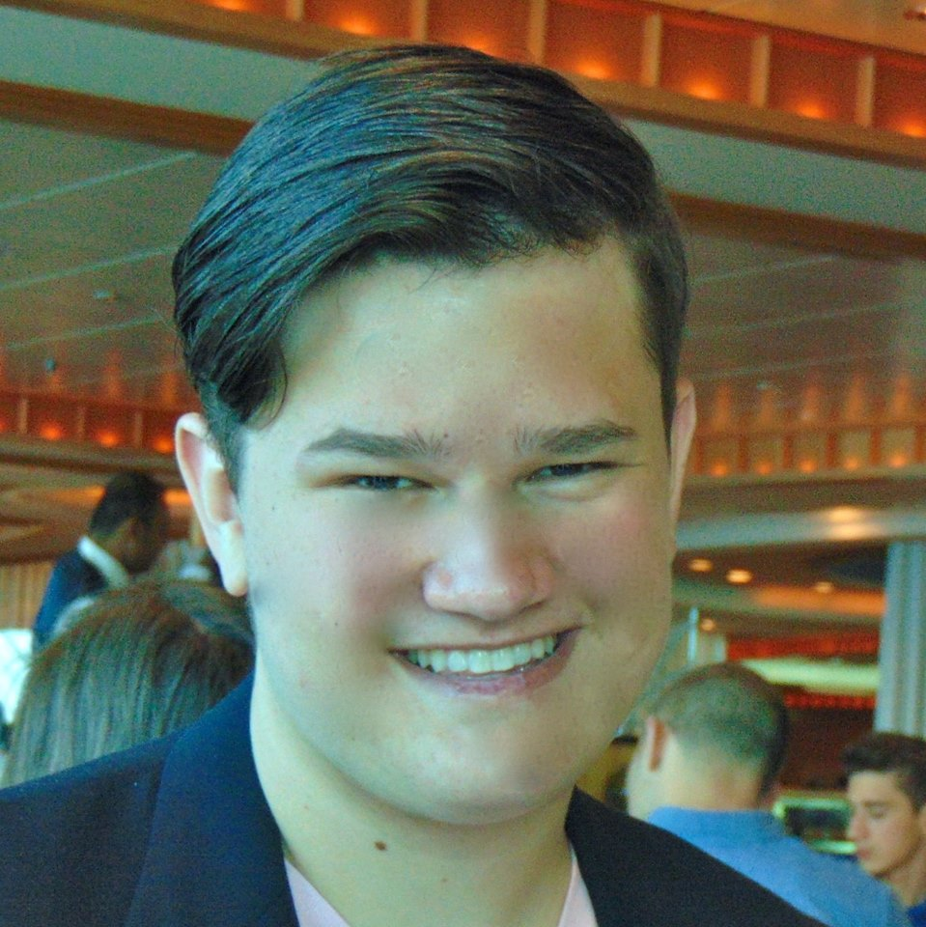
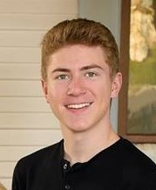
Team U.I. Fit
Charles Chatwin
Team Leader
Tanner Brelje
Database Designer
Matthew Burns
Web Designer
Joshua Gutman
Release Manager

Slide 3
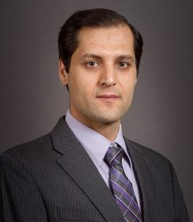
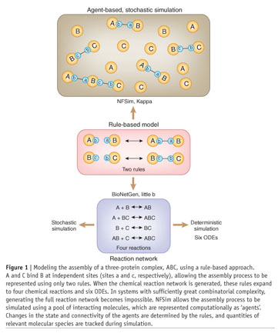
Mentor and Client:
Dr. Abolfazl Razi
Assistant Professor of Electrical Engineering in the School of Informatics, Computing and Cyber Security (SICCS) at Northern Arizona University.
B.Sc., M.Sc., and Ph.D. in Electrical Engineering.
Accomplished work to quantify the biological process along with researchers at Los Alamos and Dr. Posner.
Notes:
The image is about reaction rules (bottom, bionetgen) the way it is implemented in running (middle) and how it is reacted together (final result graphically) (top, nfsim) when it finishes.

Slide 4
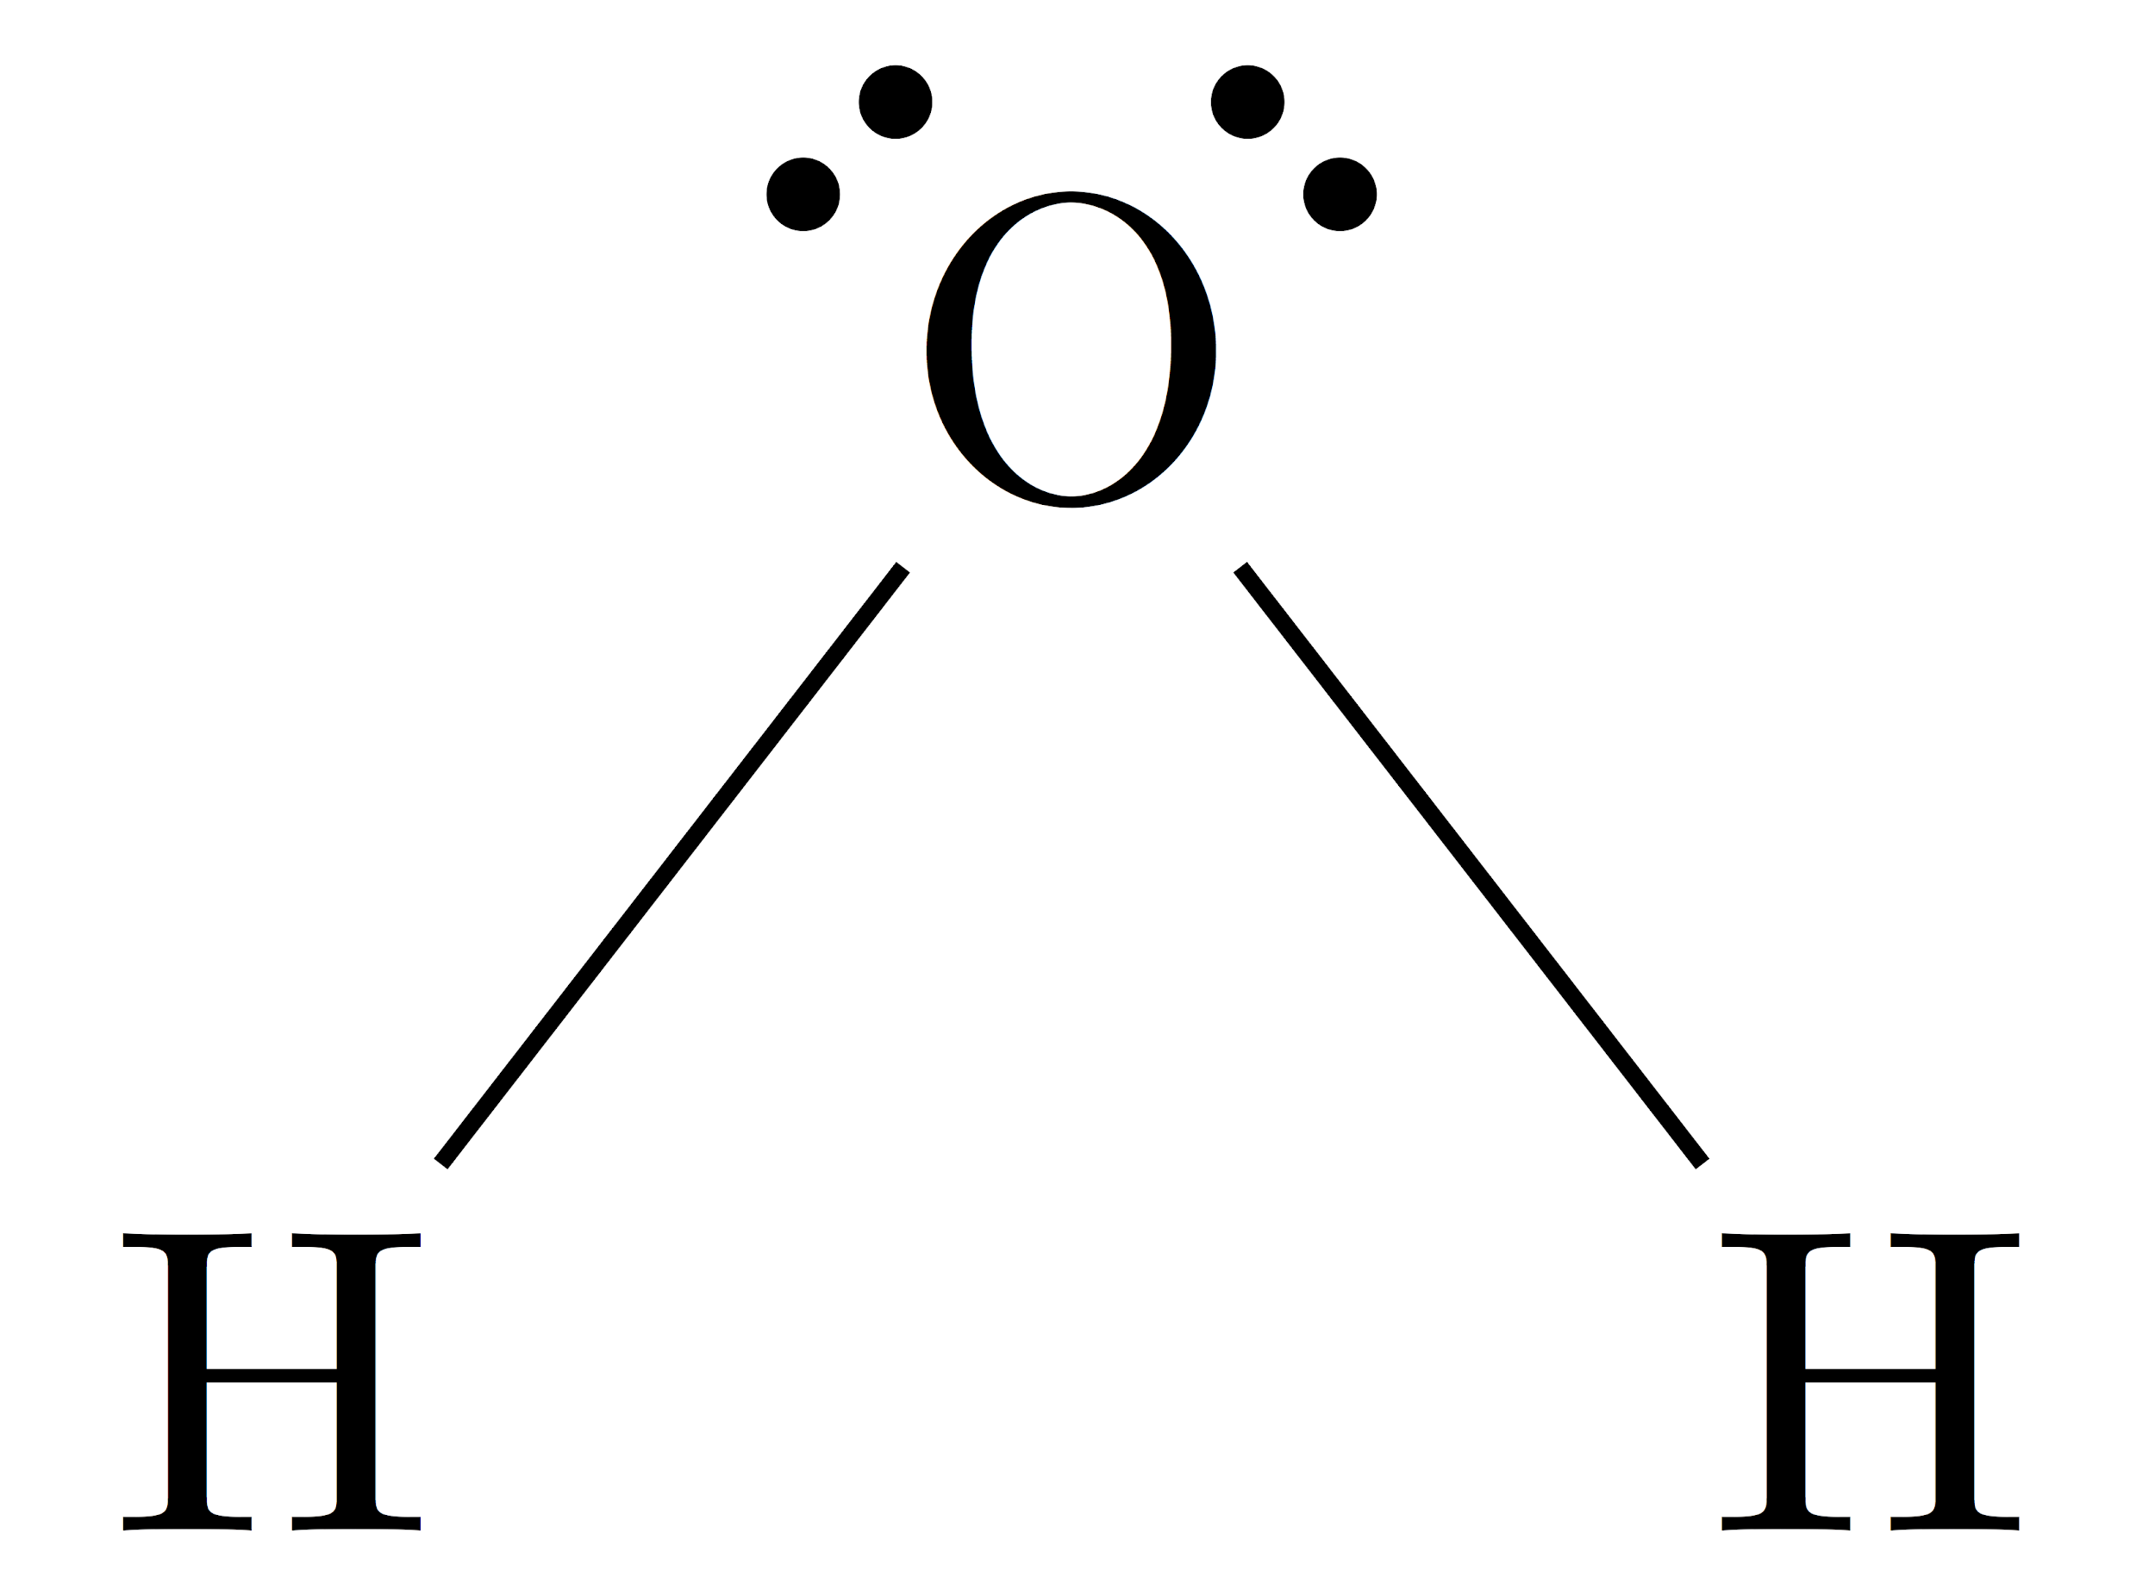
Molecular Biology
Molecular biology, as the name would suggest, refers to the study of biology at the molecular level of life. Experts within the field must have intense knowledge of chemistry, biology, and genetics.
In order to push the boundaries of the field, researchers must conduct experiments based around molecular combinations. A barebones example of this process is the combination of H2 and O to make H2O, or water.
Of course, the process is almost never that simple...

Slide 5
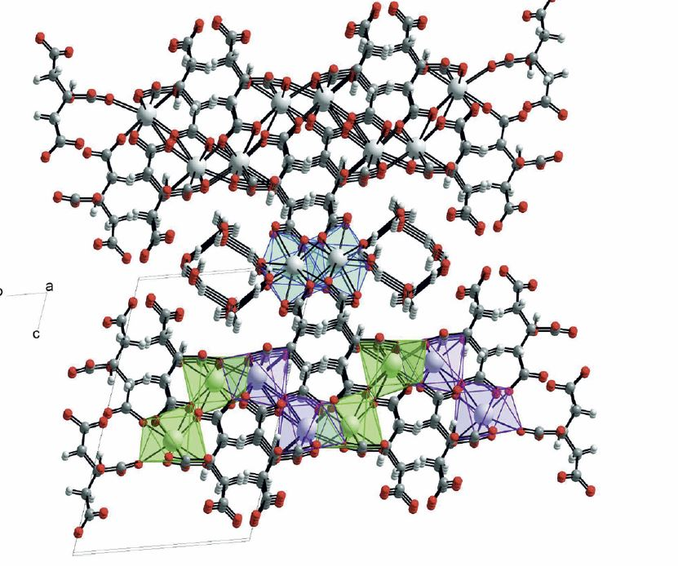
Calcium Citrate Crystal
Often found in dietary supplements.
Made from egg shell and lime.

Slide 6
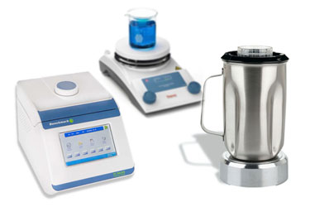
Molecular Biology
For large scale experiments, there are endless costs. These range from maintaining the equipment within a lab, to purchasing and obtaining necessary resources for the experiment itself.
Time is also a large hindrance, as real world molecular experiments can take days at a time.
What’s worse, is if the experiment is a bust and yields no results, all of the money and time used to conduct it becomes wasted.

Slide 7
Exactly How Much?
Ignoring the $500,000 to $1,000,000 dollars required to build a university lab…
Consumables and materials can cost $20,000 a year.
A single 5 mg bottle of reactant could cost $300 easily.
Buying new equipment, maintenance can cost $5,000 to $100,000 a year depending on lab size.
Depending on the molecular combination, results may not be recordable for days or even weeks at a time. On top of that, experiments need to be repeated in order to verify said results.

Slide 8
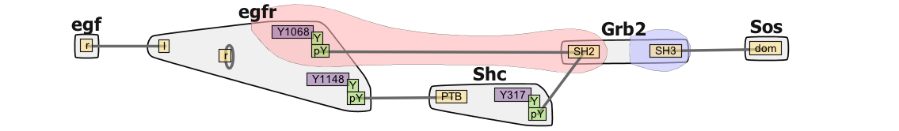
Existing Technology
BioNetFit, BioNetGen, NFSim
Uses BNGL (BioNetGen Language Files hold the rules and definitions)
User EXP (Experimental-Results file, expected results for comparison)
Uses genetic algorithms, simulated annealing, and others methods to choose the best parameters, and the next set of parameters.

Slide 9
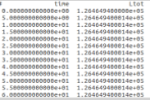
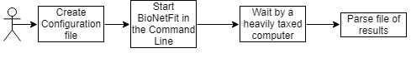
The Problem
BioNetFit suffers from poor usability.
Only exists as a command-line tool.
Results are not easily interpreted.
No visual representation of the data.
Cannot run large experiments in a reasonable timeframe.
Works accurately, but very
slowly on a single machine.

Slide 10
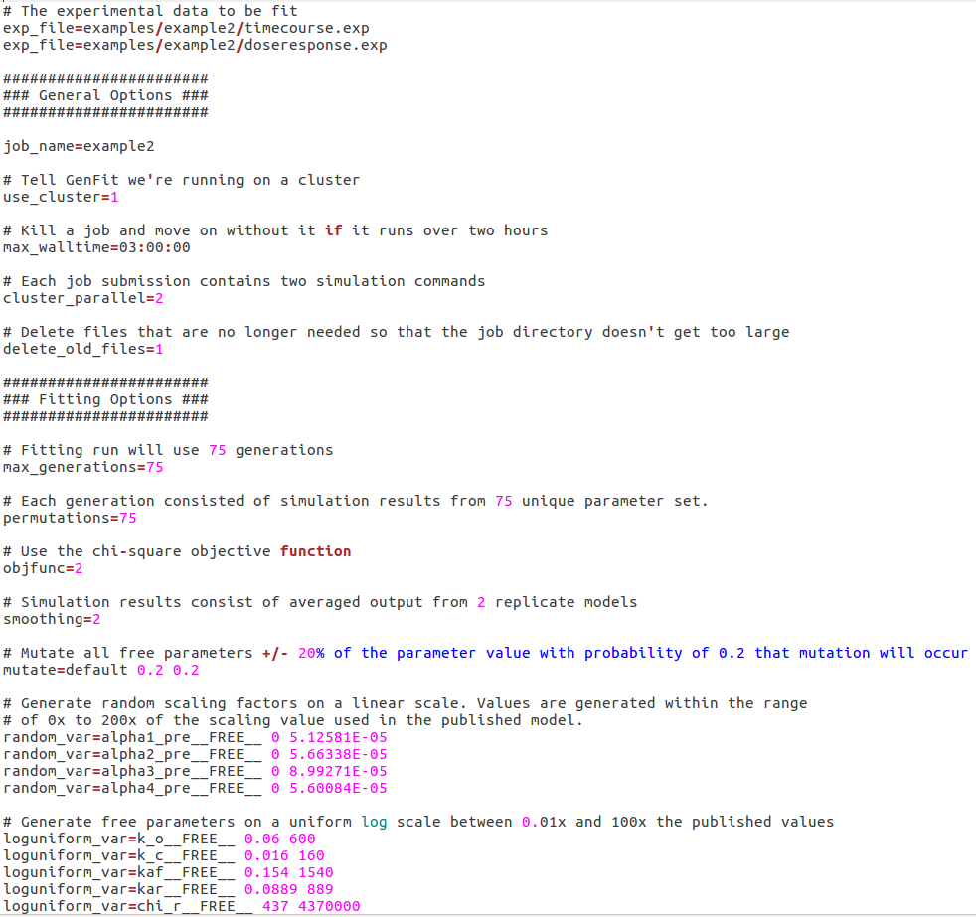
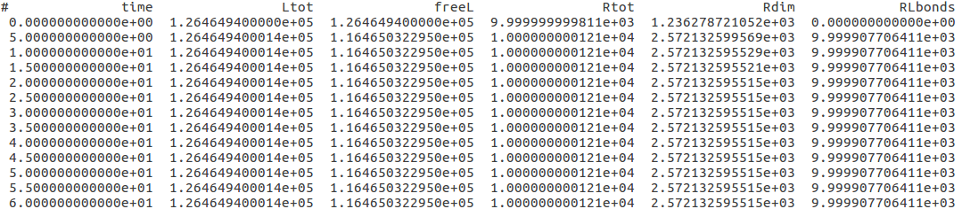
Image of bionetfit on cmd line
Example output
Example config file

Slide 11
The Problem
BioNetFit suffers from poor usability.
Only exists as a command-line tool.
Results are not easily interpreted.
No visual representation of the data.
Cannot run large experiments in a reasonable timeframe.
Works accurately, but very
slowly on a single machine.

Slide 12
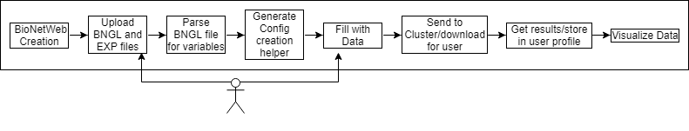
Solution Overview
Our solution is a Web 2.0 Graphical User Interface that will drastically increase the usability of BioNetFit.
Automatically generate necessary files.
Visualize results to increase ease-of-interpretation for users.
Increase workflow via NAU Monsoon cluster in order to increase processing speed.

Slide 13
Key User Requirements
The user must be able to:
Generate configuration files
Visualize results
Save all information in a database
Repeat past experiments
Download relevant run files

Slide 14

Key Technical Requirements
Dynamic HTML generation
Text fields are created from user-uploaded file
Scraping text fields
Text fields are scraped to get user-inputted information
Creating files from user-inputted information
A configuration file is created from user-inputted information
Storing information in a database
All input and output files are stored in a database for each user
Visualizing data
Plot BioNetFit output

Slide 16
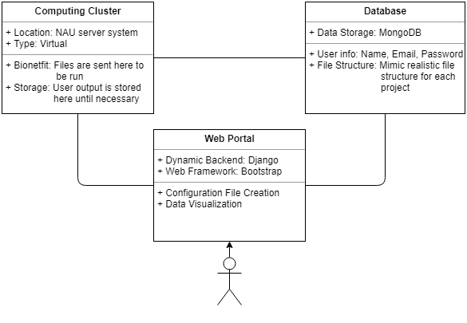
Site Architecture
Web Portal
User communication point
Visualizes data and creates files
Cluster
Communicates with Web Portal and Database
Runs BioNetFit
Database
Stores user profiles
Holds users projects

Slide 17
Technologies
Requirement | Fulfilled By | Discarded Alternatives
Dynamic HTML Generation | Django | PHP
Scraping Text Fields | Javascript | Django
Creating Files | Javascript | Django
SSH from server to server | Paramiko | -
Database | MongoDB / PyMongo | MySql
Visualizing Data | D3 | MatPlotLib, Plotly

Slide 18

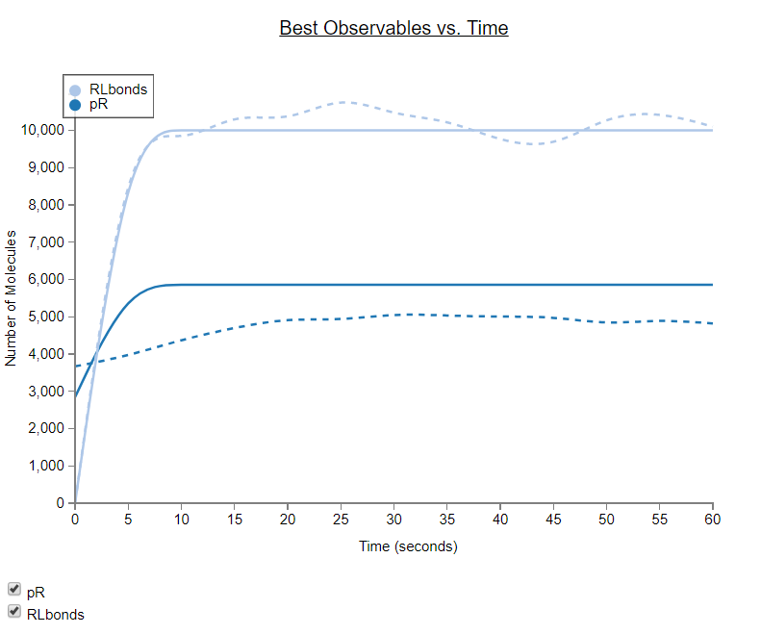
Visualizing Data
D3
Read output of BioNetFit
Write each data point to a CSV file
Transfer data to webserver
Create plot using D3
Other methods of visualization can be added

Slide 19
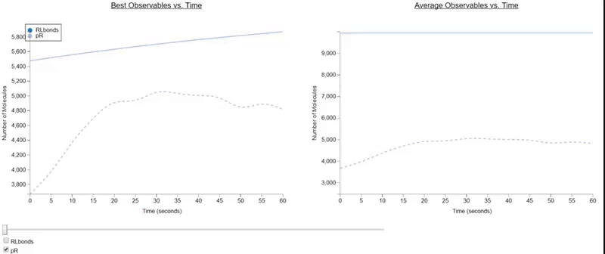
Interactive Visualization

Slide 20
Risks and Feasibility
Possible Risks | Importance | Steps Towards Mitigation
Unable to access NAU Monsoon Cluster. | Medium | We received a virtual cluster that will act as a proof of concept for the site.
Insecure storage and usage of Monsoon login details. | High | Login information is as secure as the webserver.
Securing a Domain to host the BioNetFit GUI. | Low | A domain has been secured using NAU’s webservices.
Database leaks personal data of the user. | Low | No private data is stored within the user database (i.e. Name, Password, Email).
Notes:
Challenges and Resolutions
(about 2 minutes) -- replaces risks and feasibility Now you are in the thick of implementation, so you
should focus on coding challenges here. Briefly introduce a few of the challenging questions or problems that have come up in your implementation (e.g. “Computing spatial layout of nodes in our graphical state view”), briefly describe the problem, then present your solution...or ideas you’re working on to address it (maybe someone in the audience has some input or help for you, who knows). In any case, your goal here is to show that you have recognized some key implementation challenges and are well into solving them.

Slide 21
Successes and Failures
Successes:
Database successfully implemented without use of personal data.
Pythonic implementation of website as well as additional features.
Dynamic creation of files, upload and download functionality.
A virtual environment of Monsoon has been provided as a proof-of-concept.
Failures:
Access to Monsoon has been denied due to possible security risks.
Preliminary visualization methods were unsustainable.
Notes:
Change risks to challenges
Now you are in the thick of implementation, so you
should focus on coding challenges here. Briefly introduce a few of the challenging questions or problems that have come up in your implementation (e.g. “Computing spatial layout of nodes in our graphical state view”), briefly describe the problem, then present your solution...or ideas you’re working on to address it (maybe someone in the audience has some input or help for you, who knows). In any case, your goal here is to show that you have recognized some key implementation challenges and are well into solving them.

Slide 22
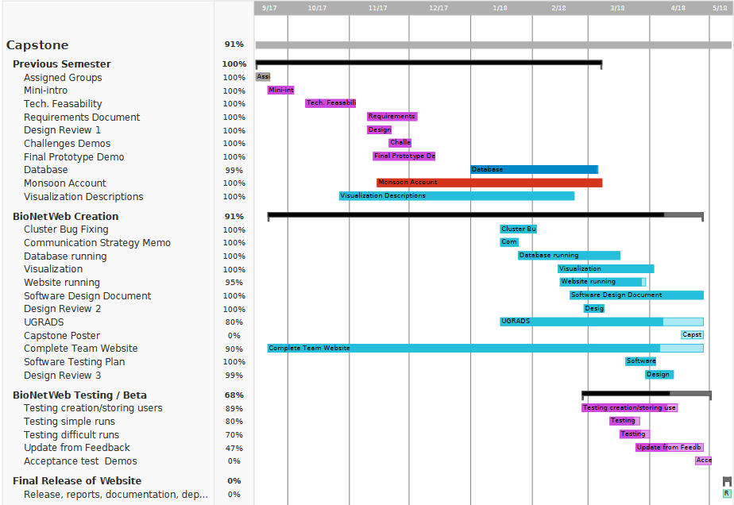
Schedule
Notes:
As usual, offer a short discussion of your project
plan, as it stands right now. A Gantt chart is highly recommended, with a “now” line running through it.
Go over your main functional milestones...which ones you’re through and what’s
coming. Close with some summary statement of where you are “going well”, “somewhat behind, but we think we can catch up”, whatever.

Slide 23
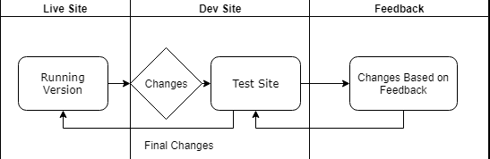
Testing Plan
Subject | What Needs Testing | Testing Method
Web Portal | Needs to be simple and accessible | Create niche and complicated input files
Database | Needs to store information and limit use | Store multiple large projects
Visualizations | Needs to be reactive and robust | Generate multiple visualizations with correct and incorrect data
Web Services | Needs to have a fast response with the virtual cluster | Download multiple output files and project archives from the virtual cluster
Notes:
Web portal- simple, easy to input files Database- store files, limit files stored. Organize into user data
visualizations-
Successful Response
The user is able to quickly and easily create and download input files with all the fields they need.
The database accepts a certain amount of projects before forcing the user to delete old projects before continuing.
The website generates the visualizations if possible. If not, it creates an error message informing the user why the failure occurred.
The website quickly generates and serves the desired files to the user.

Slide 24
Conclusion
The Problem: BioNetFit is not easy to use, requires a lot of time to process huge experiments, and gives outputs that are hard for researchers to digest.
Our Solution: A Web 2.0 GUI that will increase ease-of-use, implemented with parallelization on the Monsoon cluster, and clear visualizations of outputs.
Implementation via Python Framework
Django, Paramiko, vanilla Python, etc.
Risks to design can be overcome via feasible options.
Notes:
Conclusion (about 1 minute)
Finish your talk by providing a solid summary of your presentation: This
is where you wrap it all up nicely and bring it all together. Start by briefly restating the importance of the domain, your client’s business and processes and what was
inefficient about them. Then review your solution vision, and go on to review what key topics you’ve discussed in this
Design Review; do NOT review the details of those topics (you did that already in the middle part), just review what you
talked about and the overall outcomes: Requirements acquisition, development of detailed Functional, Performance,
Environmental requirements, and risks/feasibility. End your conclusion with a sentence or two about what’s coming up for you, what you’ll be focusing on in the next
development phase. End the presentation with an energetic note that conveys professionalism and
confidence that you’ll be able to solve the problems and satisfy your client.

